Slide 1
Linear Algebra

Slide 2
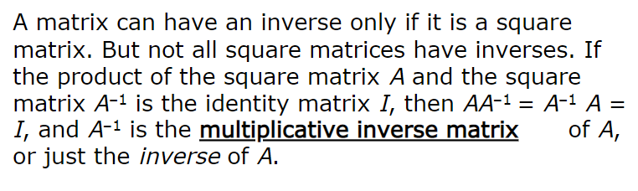
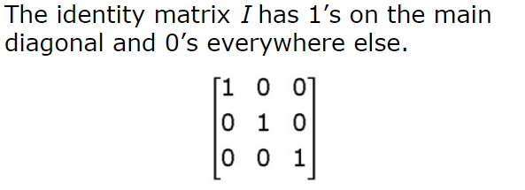
The Inverse of a Matrix

Slide 3
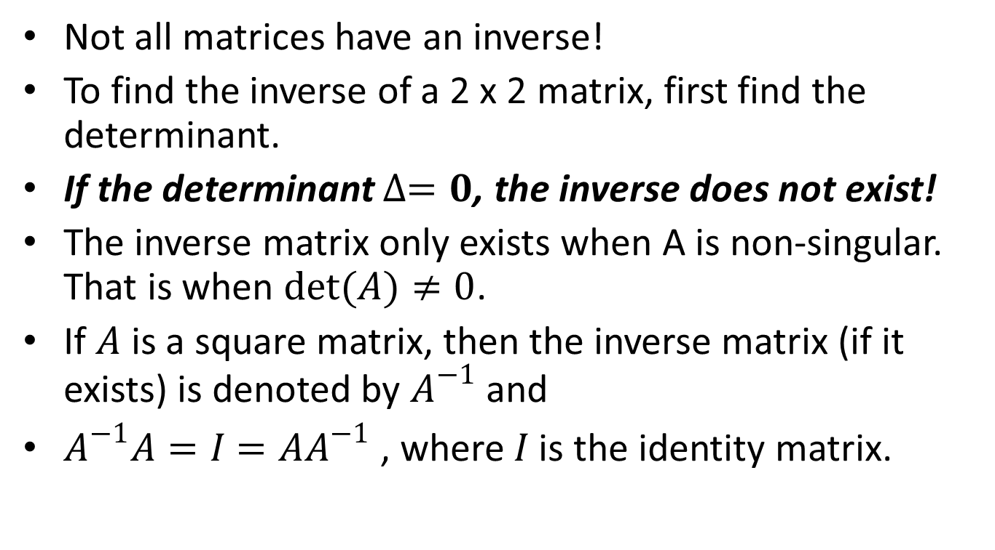
The Inverse of a Matrix
Not all matrices have an inverse!
To find the inverse of a 2 x 2 matrix, first find the determinant.
If the determinant $∆=0$, the inverse does not exist!
The inverse matrix only exists when A is non-singular. That is when $det(A)≠0$.
If $A$ is a square matrix, then the inverse matrix (if it exists) is denoted by $A^{−1}$ and
$A^{−1}A=I=AA^{−1}$ , where $I$ is the identity matrix.

Slide 4
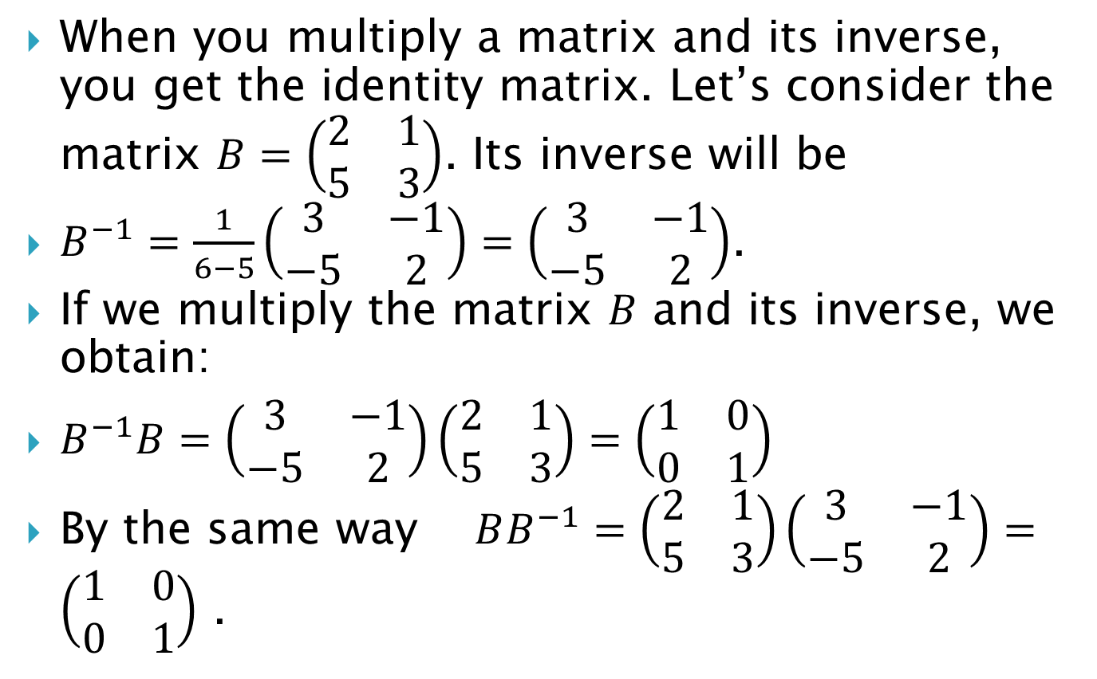
When you multiply a matrix and its inverse, you get the identity matrix. Let’s consider the matrix $B=\left(\begin{matrix}2 & 1 \\ 5 & 3\end{matrix}\right)$. Its inverse will be
$B^{−1}=\frac{1}{6−5}\left(\begin{matrix}3 & −1 \\ −5 & 2\end{matrix}\right)=\left(\begin{matrix}3 & −1 \\ −5 & 2\end{matrix}\right)$.
If we multiply the matrix $B$ and its inverse, we obtain:
$B^{−1}B=\left(\begin{matrix}3 & −1 \\ −5 & 2\end{matrix}\right)\left(\begin{matrix}2 & 1 \\ 5 & 3\end{matrix}\right)=\left(\begin{matrix}1 & 0 \\ 0 & 1\end{matrix}\right)$
By the same way $BB^{−1}=\left(\begin{matrix}2 & 1 \\ 5 & 3\end{matrix}\right)\left(\begin{matrix}3 & −1 \\ −5 & 2\end{matrix}\right)=\left(\begin{matrix}1 & 0 \\ 0 & 1\end{matrix}\right)$ .

Slide 5
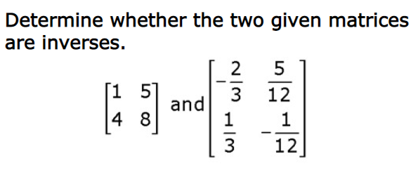
Example 1.

Slide 6
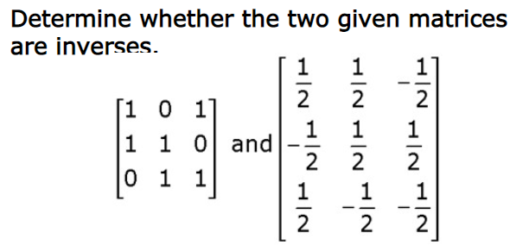
Example 2.

Slide 7
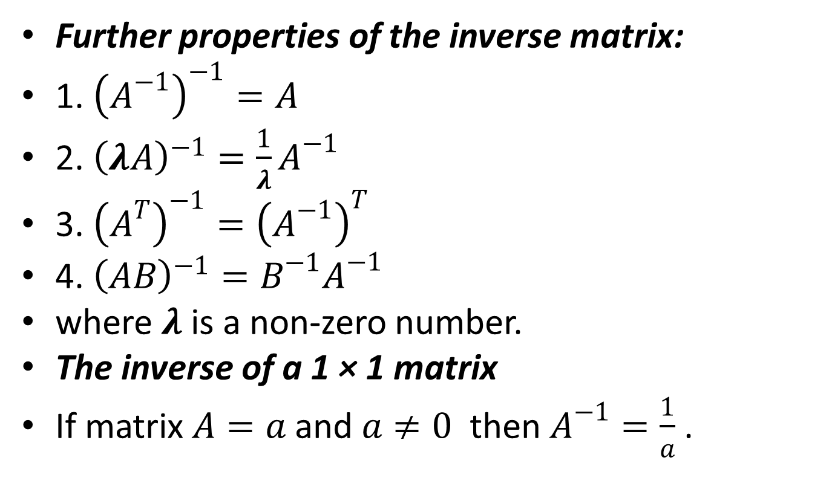
Further properties of the inverse matrix:
1. ${\left(A^{−1}\right)}^{−1}=A$
2. ${\left(λA\right)}^{−1}=\frac{1}{λ}A^{−1}$
3. ${\left(A^{T}\right)}^{−1}={\left(A^{−1}\right)}^{T}$
4. ${\left(AB\right)}^{−1}=B^{−1}A^{−1}$
where $λ$ is a non-zero number.
The inverse of a 1 × 1 matrix
If matrix $A=a$ and $a≠0$ then $A^{−1}=\frac{1}{a}$ .

Slide 8
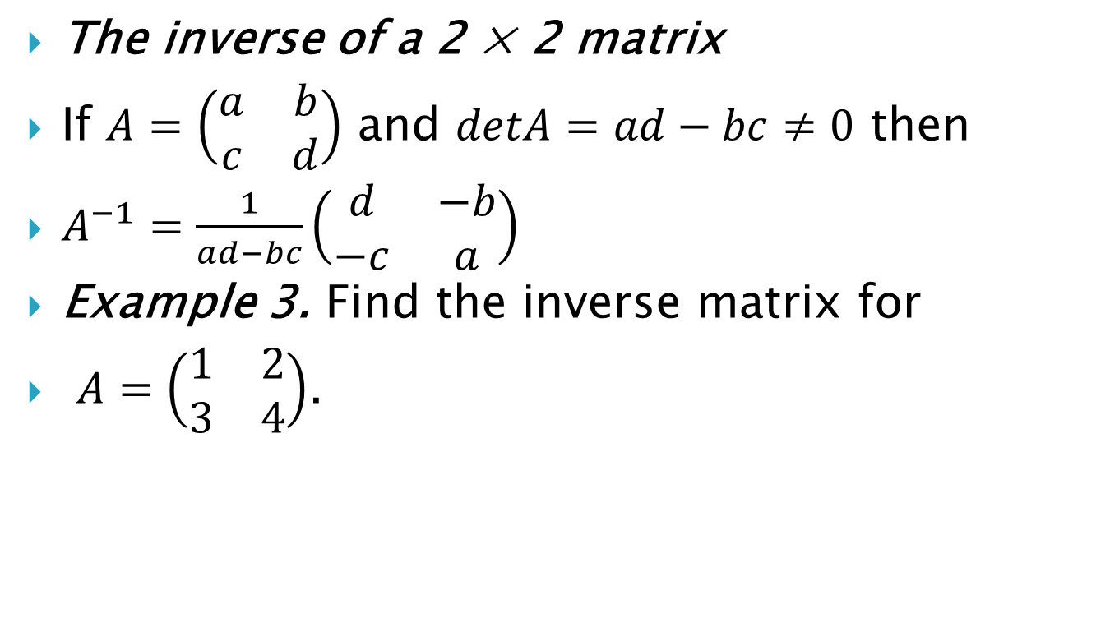
The inverse of a 2 × 2 matrix
If $A=\left(\begin{matrix}a & b \\ c & d\end{matrix}\right)$ and $detA=ad−bc≠0$ then
$A^{−1}=\frac{1}{ad−bc}\left(\begin{matrix}d & −b \\ −c & a\end{matrix}\right)$
Example 3. Find the inverse matrix for
$A=\left(\begin{matrix}1 & 2 \\ 3 & 4\end{matrix}\right)$.

Slide 9

Example 4. Find the inverse of a matrix:
$a) A=\left(\begin{matrix}3 & 6 \\ 2 & −1\end{matrix}\right)$
$b) B=\left(\begin{matrix}3 & −2 \\ −6 & 4\end{matrix}\right)$

Slide 10
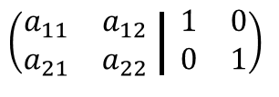
Finding the inverse of a matrix
Gauss-Jordan method
Steps to find the inverse of a matrix
using Gauss-Jordan method:
1.Set up the given matrix with the identity matrix as the form of
2.Transforming the left Matrix into the identical matrix follow the rules of Row operations.

Slide 11


Example 5. Find the inverse of a matrix by using Gauss-Jordan method:

Slide 12
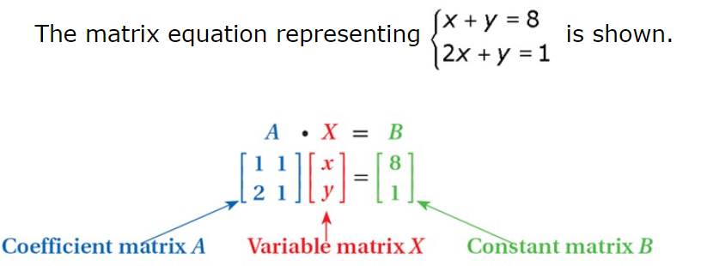

The matrix inverse can be used to find the solution $\overline{x}$ of $A\overline{x}=\overline{b}$. It is $\overline{x}=A^{−1}\overline{b}$ if and only if $detA≠0$.

Slide 13
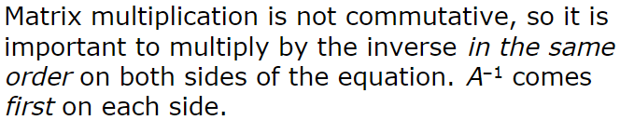

Slide 14

Example 6. Solve the system of equations using the inverse matrix:
$\left\{\begin{aligned}3x+5y=13 \\ −x+4y=7\end{aligned}\right.$

Slide 15
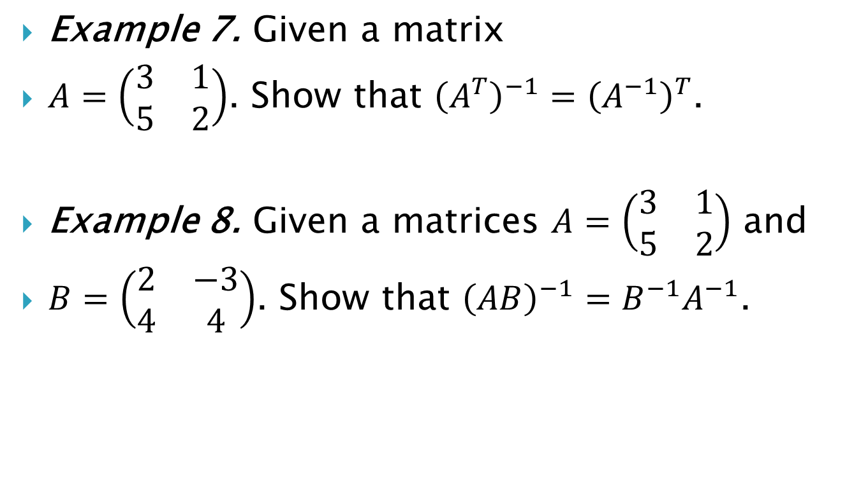
Example 7. Given a matrix
$A=\left(\begin{matrix}3 & 1 \\ 5 & 2\end{matrix}\right)$. Show that ${\left(A^{T}\right)}^{−1}={\left(A^{−1}\right)}^{T}$.
Example 8. Given a matrices $A=\left(\begin{matrix}3 & 1 \\ 5 & 2\end{matrix}\right)$ and
$B=\left(\begin{matrix}2 & −3 \\ 4 & 4\end{matrix}\right)$. Show that ${\left(AB\right)}^{−1}=B^{−1}A^{−1}$.

Slide 16
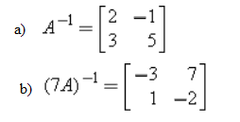
Example 9. Find a matrix A, if

Slide 17
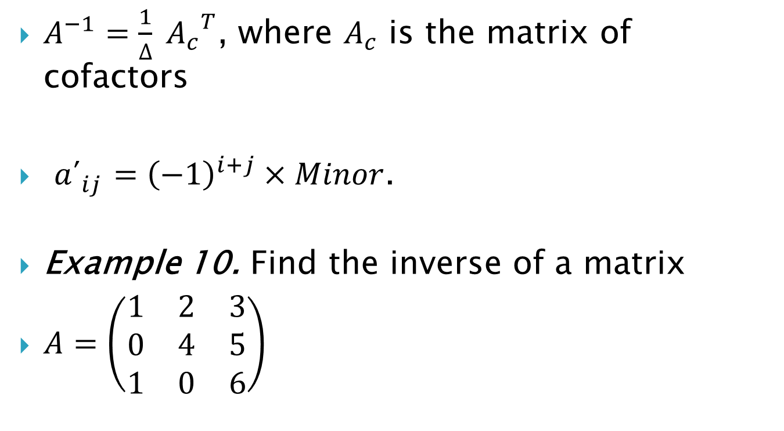
$A^{−1}=\frac{1}{∆} {A_{c}}^{T}$, where $A_{c}^{ }$ is the matrix of cofactors
${a´}_{ij}^{}={\left(−1\right)}^{i+j}×Minor$.
Example 10. Find the inverse of a matrix
$A=\left(\begin{matrix}1 & 2 & 3 \\ 0 & 4 & 5 \\ 1 & 0 & 6\end{matrix}\right)$

Slide 18
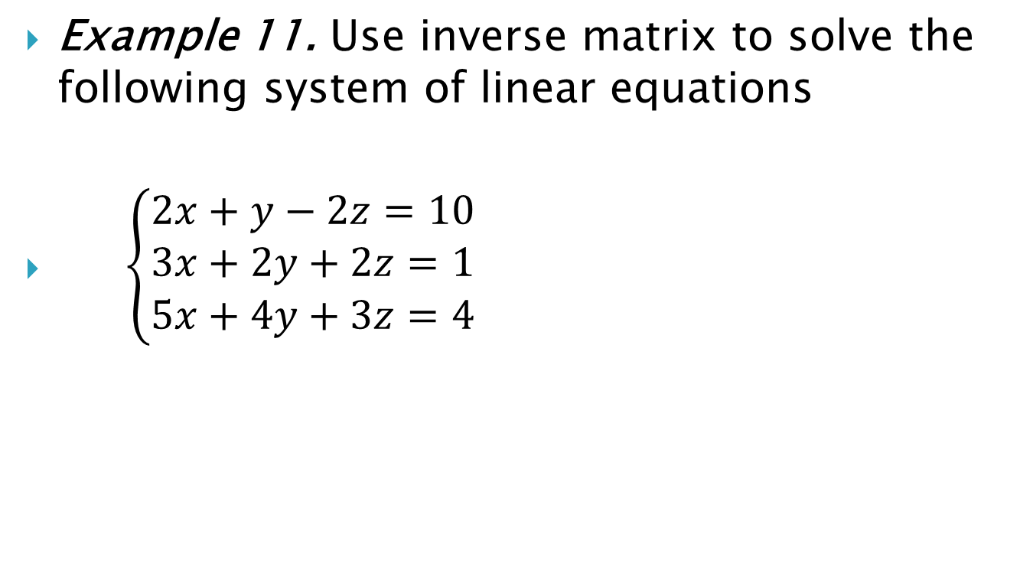
Example 11. Use inverse matrix to solve the following system of linear equations
$\left\{\begin{aligned}2x+y−2z=10 \\ 3x+2y+2z=1 \\ 5x+4y+3z=4\end{aligned}\right.$

Slide 19

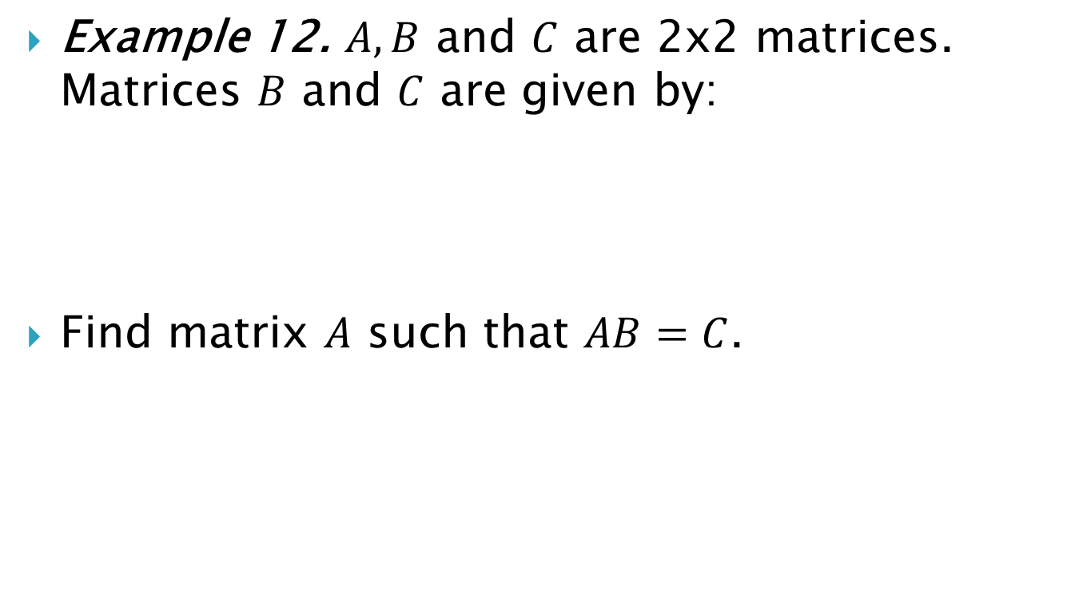
Example 12. $A, B$ and $C$ are 2x2 matrices. Matrices $B$ and $C$ are given by:
Find matrix $A$ such that $AB=C$.

Slide 20
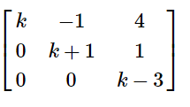

Example 13. Find such value of $k$ for which the matrix below is invertible

Slide 21
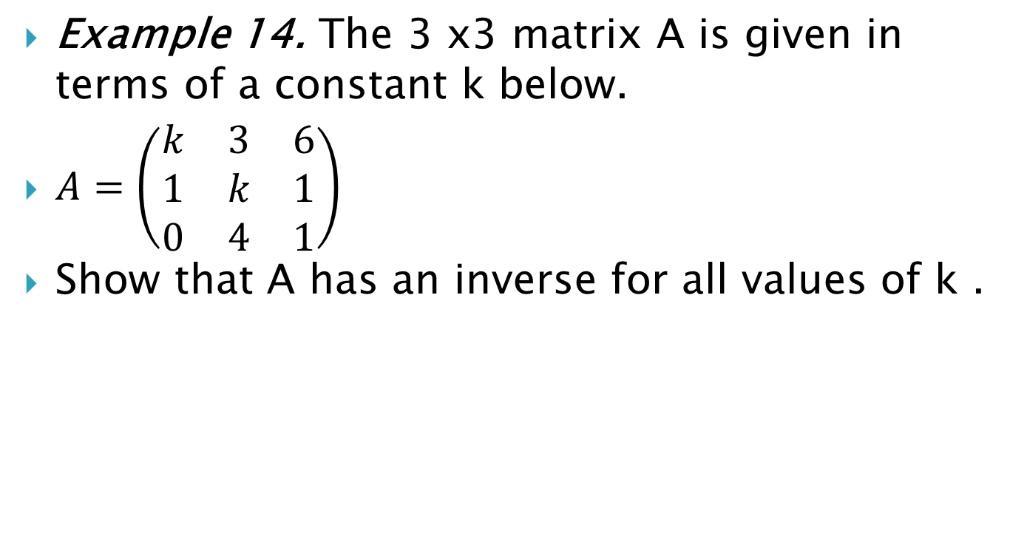
Example 14. The 3 x3 matrix A is given in terms of a constant k below.
$A=\left(\begin{matrix}k & 3 & 6 \\ 1 & k & 1 \\ 0 & 4 & 1\end{matrix}\right)$
Show that A has an inverse for all values of k .

Slide 22
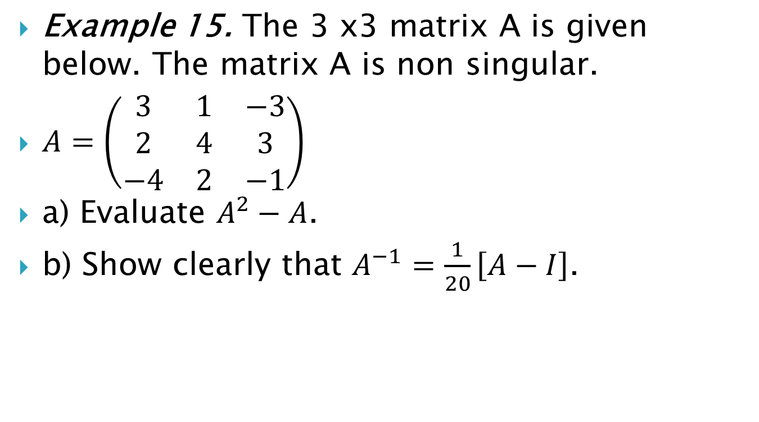
Example 15. The 3 x3 matrix A is given below. The matrix A is non singular.
$A=\left(\begin{matrix}3 & 1 & −3 \\ 2 & 4 & 3 \\ −4 & 2 & −1\end{matrix}\right)$
a) Evaluate $A^{2}−A$.
b) Show clearly that $A^{−1}=\frac{1}{20}\left[A−I\right]$.

Slide 23
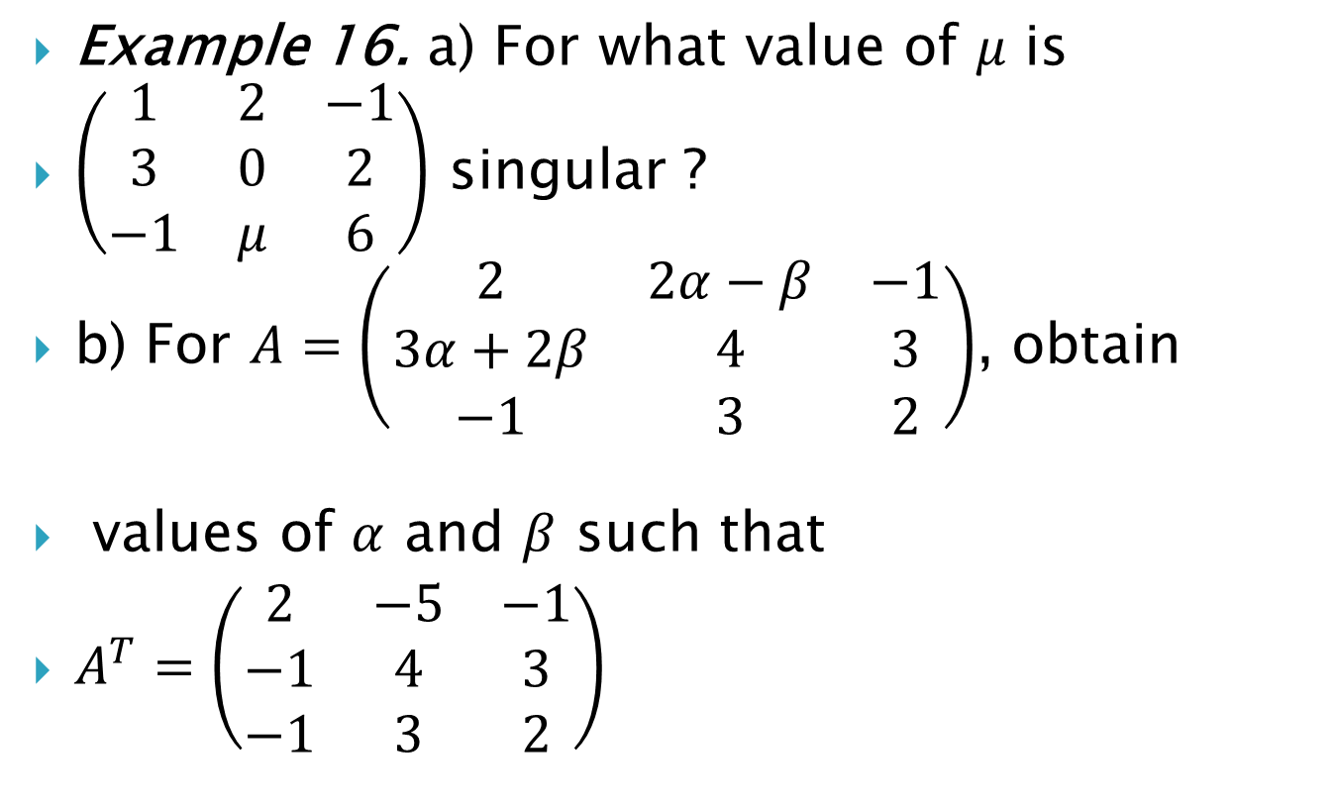
Example 16. a) For what value of $μ$ is
$\left(\begin{matrix}1 & 2 & −1 \\ 3 & 0 & 2 \\ −1 & μ & 6\end{matrix}\right)$ singular ?
b) For $A=\left(\begin{matrix}2 & 2α−β & −1 \\ 3α+2β & 4 & 3 \\ −1 & 3 & 2\end{matrix}\right)$, obtain
values of $α$ and $β$ such that
$A^{T}=\left(\begin{matrix}2 & −5 & −1 \\ −1 & 4 & 3 \\ −1 & 3 & 2\end{matrix}\right)$

